Slide 1
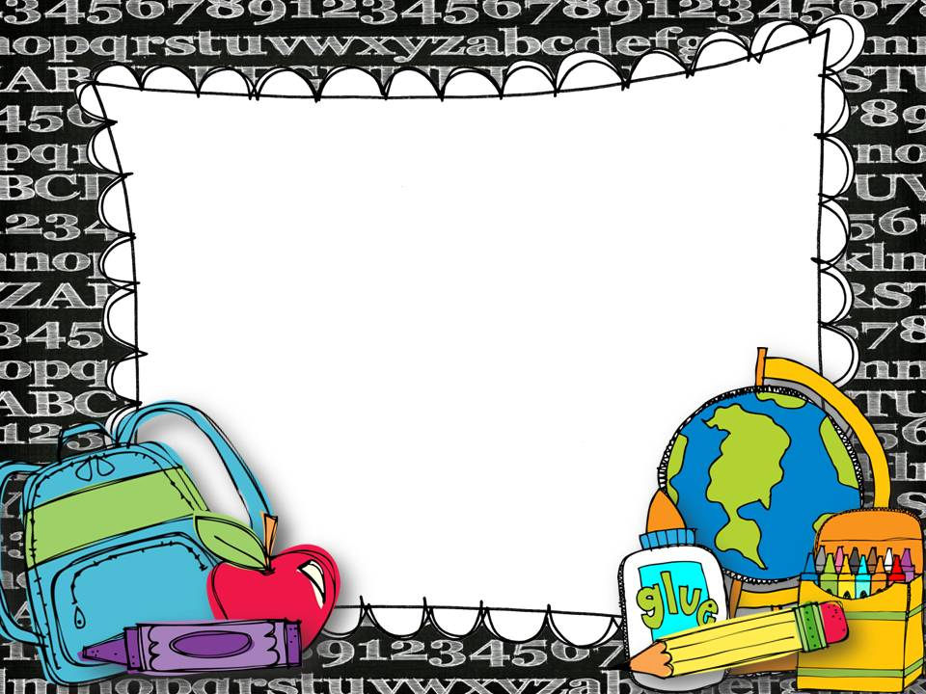
Habit, Community,
and Culture
Mrs. Fodor

Slide 2
What is Social Emotional Learning?
Social-emotional learning (SEL) is the process through which children and adults acquire and effectively apply the knowledge, attitudes, and skills necessary to understand and manage emotions, set and achieve positive goals, feel and show empathy for others, establish and maintain positive relationships, and make responsible decisions.

Slide 3
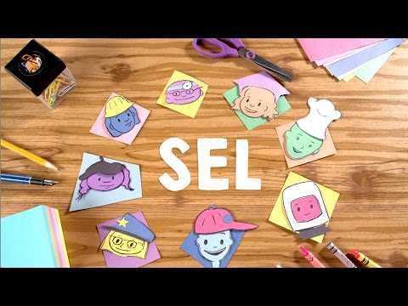

Slide 4
Class
* 44 minutes
* One marking period course
*Advisory meetings (discussion and reflection)
*Brain breaks

Slide 6
SEL Competencies
Self Awareness
Social Awareness
Self Management
Relationship Skills
Decision Making

Slide 7
Units
*Mindset and Goals
-Growing your brain
-Personalities
-Goal setting
*Values and Friendship
-Values and decisions
-Making friends and challenges

Slide 8
*Thoughts, Emotions, and Decisions
-How emotions affect decision making
-Using values to make good decisions
-Calming down
*Peer Conflicts
-Recognizing perspectives
-Resolving conflicts
-Making amends
-Bullying
-Healthy vs. unhealthy relationships

Slide 9
Grading
*Classwork/Participation 40%
*Homework 10%
*Assessment 50%

Slide 10
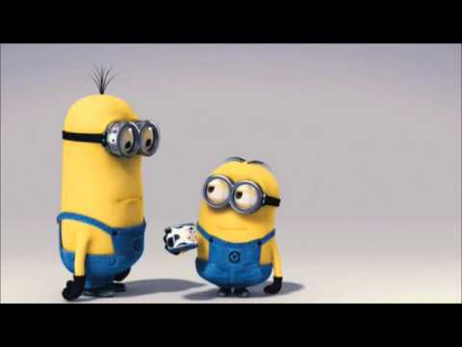

Slide 12
I look forward to a wonderful year ☺
rfodor@jacksonsd.org

